Slide 1
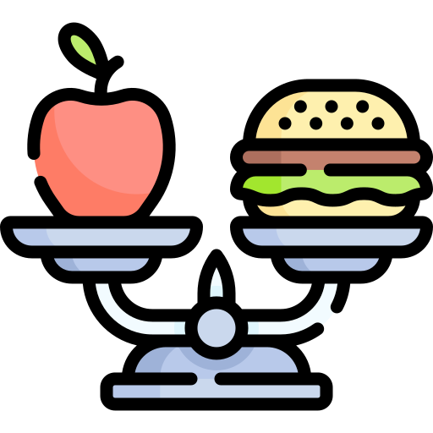
SMART DIET
Guide:-
Archana Kale Ma’am
Team Members :-
Soham Amare - 06
Aarna Bafna - 11
Shawn D’costa – 26
Shivam Killarikar - 66
Group No. : 09

Slide 2

Problem Statement
Unhealthy eating habits and lifestyles attract health issues, such as obesity, diabetes, and cardiovascular diseases.
This app should empower users to take control of their dietary habits, make healthier choices and achieve their wellness goals.
70% Nutrition
HEALTHY BODY
Our Solution will use :
Java
JavaFX
(awt & Swings)
Database will be created using MySQL
Existing diet apps often fail to consider:
Individual preferences
Dietary restrictions
Do not provide effective means of monitoring progress
30% Physical Activity

Slide 3
Problem Domain
We help in implementation of a proper diet that has JUST the right amount of proteins, carbohydrates, fats, calories intake.
User creates an account and inputs data like height and weight that helps in generating the BMI.
Medical information and food intolerances are taken in consideration.
Target weight (Loss/Gain) of the User is input.
User data shall help in displaying a personalized diet accordingly.

Slide 4
General System Flow
Sign Up/Login
Taking Input of Personal Details
Setting Goal/Target
Taking into account Health Conditions
Generation of Personalized Diet Plan
Keeping Track of Records Daily
Weekly Update on User’s progress

Slide 5
We are ready for your Questions ! Thank You

